Slide 1


Anaf Afgani
AfganiAnaf@gmail.com
11/14/2021

Slide 2

Outline
Executive Summary
Introduction
Methodology
Results
Conclusion
Appendix

Slide 3
Executive Summary
Summary of methodologies
Data Collection from SpaceX api or webscraping from wikipages beautifulsoup library
Data Wrangling by removing the missing values and being replaced by the mean
Performing EDA with sql and then later with pandas and matplotlib
Data visuaisation is completed with the help of folium and interactive dashboards are build using plotly
To finalize machine learning model is build to predict the landing outcome

Slide 4
Introduction
Human has always looked up towards heaven and wondered what is above the earth surface in the sky.With the development of rocket and advances in electronics and other technologies it has now become achievable to send man and machines to space.The rockets are used for installing telecommunication and other Commercial Satellite to earths orbit.There has always been a demand for space exploration therefore there are many companies competing to win the space exploration battle.in the Past few years there are many private companies that came with successful space mission which clearly prooves that now space exploration is not only a government monopoly
As we all know that rocket production is quite expensive due to cutting edge technology used to lift a mass against gravity without any support.to overcome this problem few companies have come up with reusable rocket which can reduce overall cost. There is a space exploration company name Space Y who wants to compete with other companies to win the space market.Therefore we need to build a model from spacex rocket dataset inorder to predict whether we can safely land the rocket.This can help the company to predict what will be the cost of the space mission.

Slide 5


Slide 6
Methodology
Executive Summary
Data collection methodology:
Through Spacex Api or by Webscraping wikipages with beautifulsoup library
Perform data wrangling
Replacing missing values with the mean and Creating a variable that represent outcome of the mission(has value 1 for success and 0 for failure)
Perform exploratory data analysis (EDA) using visualization and SQL
Perform interactive visual analytics using Folium and Plotly Dash
Perform predictive analysis using classification models
Splitting into training and testing data
Finding best hyperparameter for SVM,Classification Trees and Logistic Regression

Slide 7
Data Collection
Data was collected by making get request to the SpaceX Api
When the request is performed the data in response object is in the json format.Before populating into pandas dataframe it has to be normalize so we use the json_normalize function
Later we realize that many column has identification number and the data which we need is missing so to overcome this problem again spacex api is used.
Various function are defined in order to colllect this missing data

Slide 8
Data Collection – SpaceX API
GitHub URL of the completed SpaceX API calls notebook
Using get request on SpaceX API
Normalizing json response
Solving missing data problem through Function(reusing SpaceX API)
Removing Falcon 1 Data
Removing missing data with mean

Slide 9
Data Collection - Scraping
GitHub URL of the completed web scraping notebook
Requesting the Falcon9 launch Wiki page
Extracting Column names from html table
Parsing launch html table

Slide 10
Data Wrangling
Csv data was stored in dataframe for analysing data.Just storing data frame cant do any good so to derive some insight few python function were ran on the dataframe.In the beginning data is in raw form therefore it contains lot of null values so isnull() function is used to understand quantity of null values present.Later value_counts function is used to count occurrence of different launch sites,Orbit and Mission outcome.
GitHub URL of your completed data wrangling
Calculating number of launches per site
Calculating number and occurrence of each orbit
Calculating mission outcome per orbit type
Creating landing outcome label from outcome column

Slide 11
EDA with Data Visualization
Data analysis can also be efficiently perform with the help of visualization.For visualization purpose we will be mostly using seaborn python library for creating scatter plots.Scatter plot will be created to find the relationship between FlightNumber and Orbit,Payload and Orbit type.Other key aspect is to analyse launch success yearly trend for this we will use lineplot.Later we will do some feature engineering to create some dummy variable and then casting of numeric columns to float will be performed.
GitHub URL of completed EDA with data visualization notebook

Slide 12
EDA with SQL
Various SQL queries are performed to do Analysis
Names of unique launch site
5 launch sites that begin with a string
Total payload mass carried by booster lauched by NASA(CRS)
Average payload mass carried by booster version F9 v1.1
date when the first successful landing outcome in ground pad was achieved
names of the boosters which have success in drone ship and have a particular payload
total number of successful and failure mission outcomes
names of the booster_versions which have carried the maximum payload mass
failed landing_outcomes in drone ship, their booster versions, and launch site
Rank the count of landing outcomes or Success between the particular date
Github Url

Slide 13
Build an Interactive Map with Folium
We used marker with a specific colour to differentiate number of successful and unsuccessful missions
Circles highlighted the launch sites on the map with annotation
Lines were used to show distance between a location with the lauch site
GitHub URL of completed interactive map with Folium map

Slide 14
Build a Dashboard with Plotly Dash
Dashboard gives a pie chart and a scatter plot
Pie Chart shows total success launches by site
We can also filter the site from chart with the help of Dropdown selecter
Scatter plot shows Correlation between payload and success for the sites selected in the dropdown menu
We can also filter the payload amount from the Slider

Slide 15
Predictive Analysis (Classification)
Summarize how you built, evaluated, improved, and found the best performing classification model
Data is preprocessed and then split into training and testing data
Different parameters are saved as a dictionary for each kind of machine learning model to perform gridsearchcv to find parameter that gives best performance
Parameters for LogisticRegression,SVM,DecisionTreeClassifier were loaded first
Finally for analysis Confusion matrix are visualized to better understand machine learning algorithm
GitHub URL
Splitting data for traning and testing
Creating dictionary for Paramerters
Confusion matrix evaluate model
Performing gridseachcv to decide best parameter

Slide 16
Results
Exploratory data analysis results
EDA
Interactive analytics demo in screenshots
Predictive analysis results

Slide 17


Slide 18
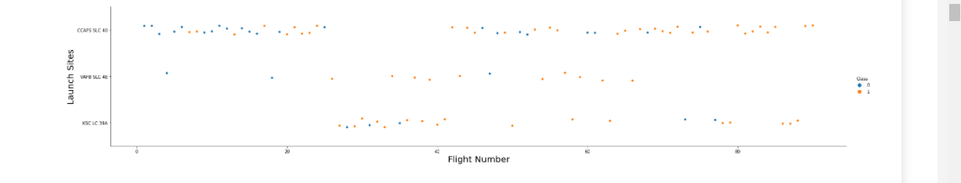
Flight Number vs. Launch Site
It can be clearly observed that from the launch site CCAFS SLC 40 many initial launches where a failure but after many launches soon this site was able to make successful launches
Same is the case with VAFB SLC 4E

Slide 19
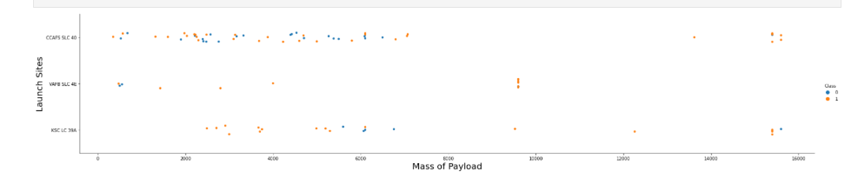
Payload vs. Launch Site
Higher payload Launches from site CCAFB SLC 40 were of class 1 same is the case with VAFB SLC 4E
But for KSC LC 39A lower payload were successful

Slide 20
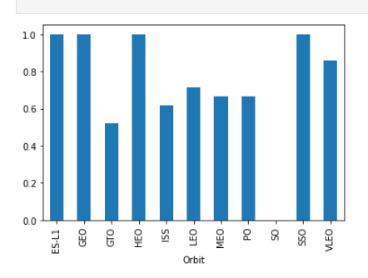
Success Rate vs. Orbit Type
With Orbit SO the success rate was zero
And orbit GTO was also very low
Other Orbit like ES-L1,GEO,HEO,SSO has complete success rate

Slide 21
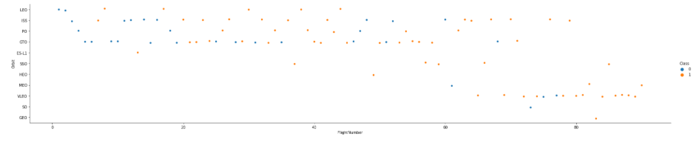
Flight Number vs. Orbit Type
Orbit like LEO orbit success rate tend to increase with flight number but with orbit GTO there tend to be relation with flight number

Slide 22
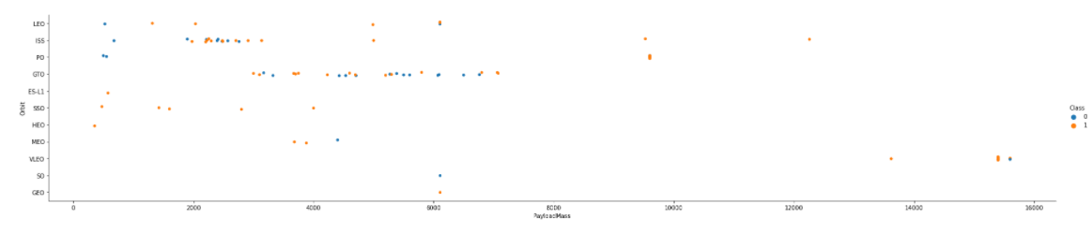
Payload vs. Orbit Type
Heavy payloads have negative impact on GTO orbit where as have positive on PO,LEO and ISS

Slide 23
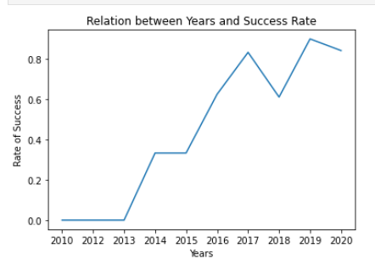
Launch Success Yearly Trend
After 2013 with every passing year rate of success increased

Slide 24
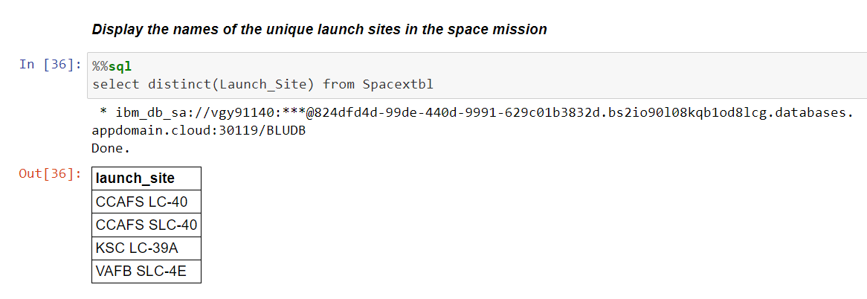
All Launch Site Names
Launch Site are abbreviation of site name
CCAFS,KSC are both situated in florida,Whereas VAFB is in California

Slide 25
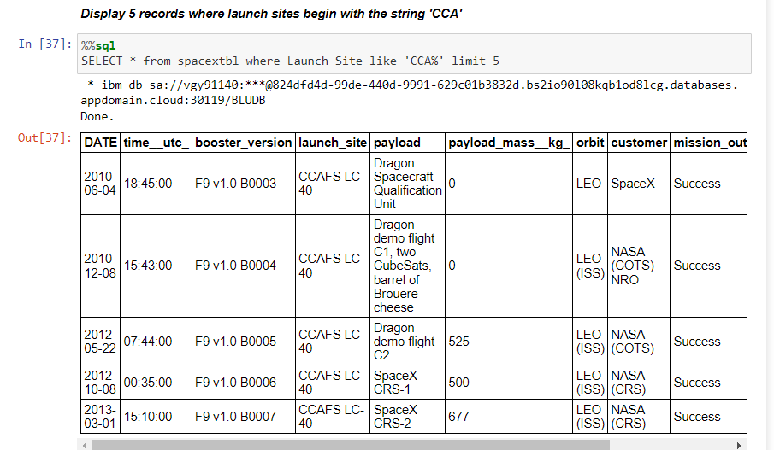
Launch Site Names Begin with 'CCA'
This query calls all the columns only with launch site that start with the string ‘CCA’.This query is performed with the help of like command.Like command only return the rows which has that particular string in the column.The query is performed with a limit, It returns first five rows.

Slide 26
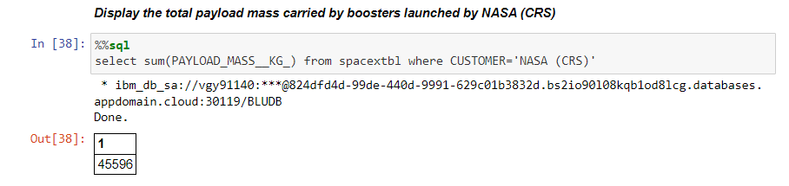
Total Payload Mass
This query returns the total sum of the payload mass in kg for the customer ‘NASA (CRS)’

Slide 27
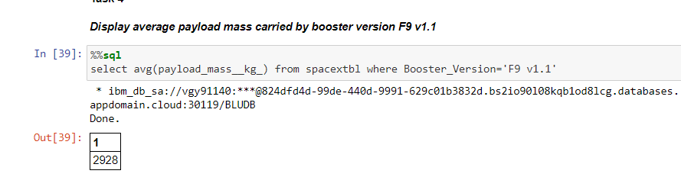
Average Payload Mass by F9 v1.1
This Query returns the average payload mass carried by booster version ‘F9 v1.1’

Slide 28
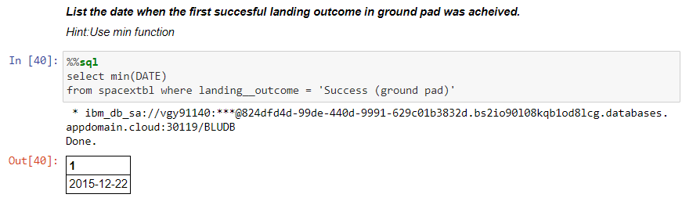
First Successful Ground Landing Date
Min function over date column returns the earliest(First) day for the landing outcome to be success on ground pad

Slide 29
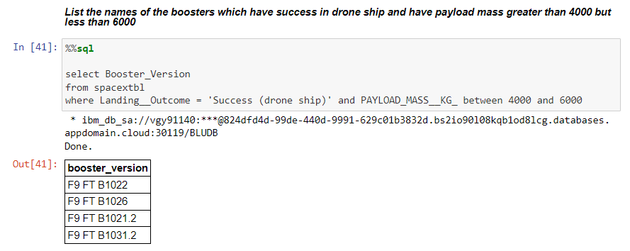
Successful Drone Ship Landing with Payload between 4000 and 6000
This Query returns booster version that has landing outcome as success (drone ship) and payload mass greater than 4000 but less than 6000.Betweem Command is used to filter data that lies within two values

Slide 30
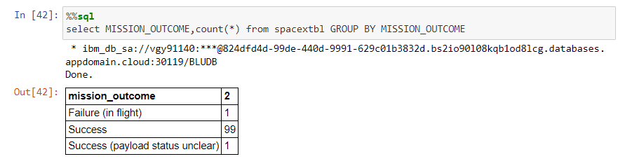
Total Number of Successful and Failure Mission Outcomes
This query calculate the total number of successful and failure mission outcomes.Group function is used to perform various aggregatation over the column in this case we used it count number of mission outcome

Slide 31
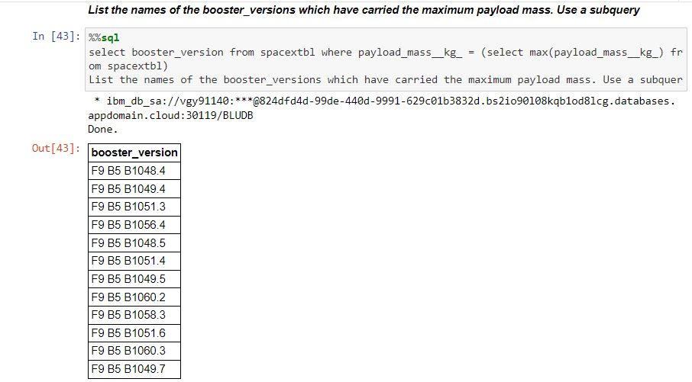
Boosters Carried Maximum Payload
Outcome contains list of the names of the booster which have carried the maximum payload mass
Sql cant directly use max(payload_mass_kg_) as to query for filtering,a subquery needs to be defined for the purpose

Slide 32
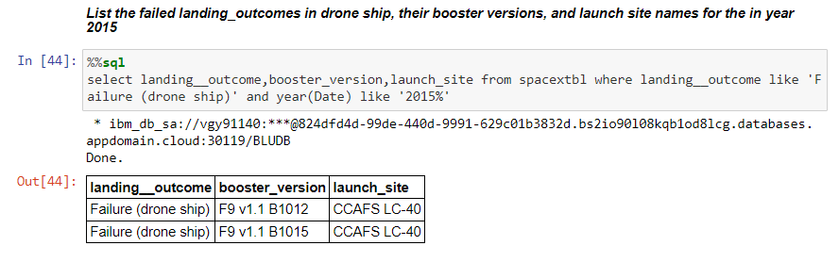
2015 Launch Records
This is the List of failed landing_outcomes in drone ship, their booster versions, and launch site names for in year 2015
Like command is used to query column containing strings like ‘Failure (drone ship) or ‘2015%’. Here % sign after 2015 avoids any string that comes after 2015 so all the days data is called irrespective of what the month or the day is,until it is in 2015

Slide 33
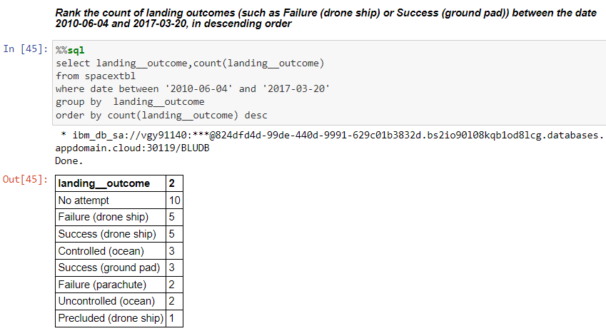
Rank Landing Outcomes Between 2010-06-04 and 2017-03-20
Data that has Rank count of landing outcomes (such as Failure (drone ship) or Success (ground pad)) between the date 2010-06-04 and 2017-03-20, in descending order
Order by command orders the data in descending order of count of landing outcome

Slide 34


Slide 35
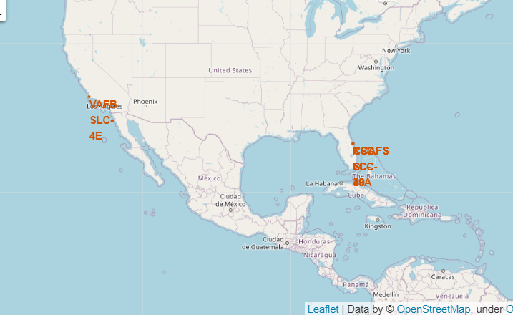
Launch Sites on Folium map
Two sites CCAFS and KSC are situated in Florida where as VAFB is located in California
Site are located on the map with the help of RED dot and it is annotated with the respective name

Slide 36
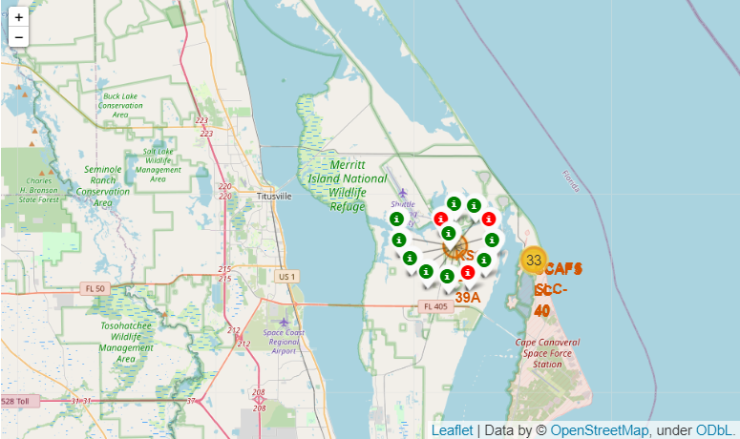
Success rate on map
Map is showing KSC launch site with success and failed launches
Green colour is success whereas red is failure

Slide 37
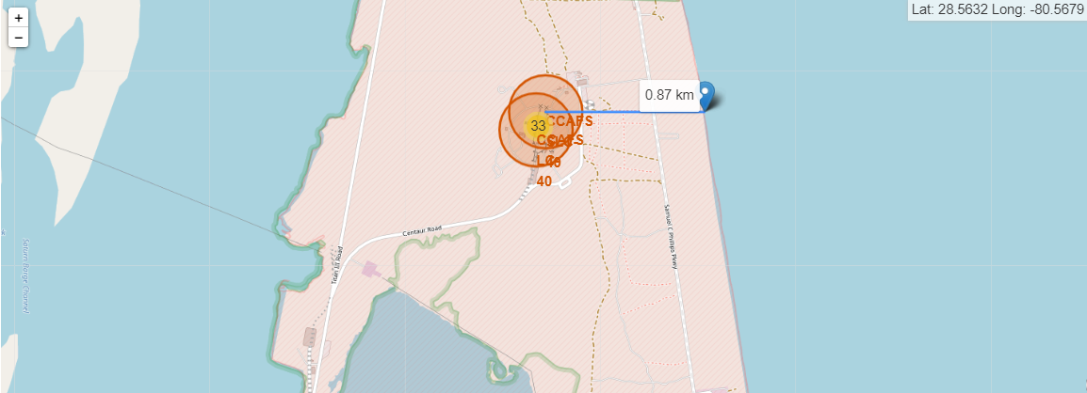
Launch site distance from coastline
This map shows the launch site as well as marker for coastline
It also includes the distance between these two points in kilometers

Slide 38


Slide 39
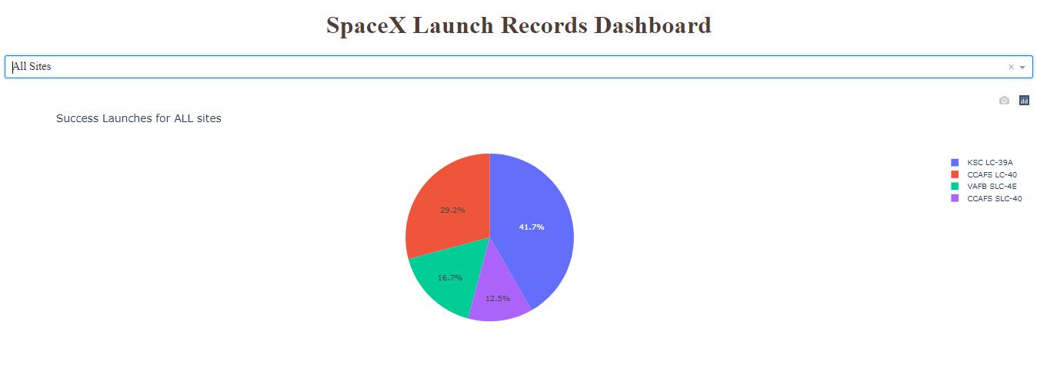
Launch Site success pie chart
Pie chart shows most launches which were successful are from KSC
This pie chart showcase success rate as percentage for all the launch sites

Slide 40
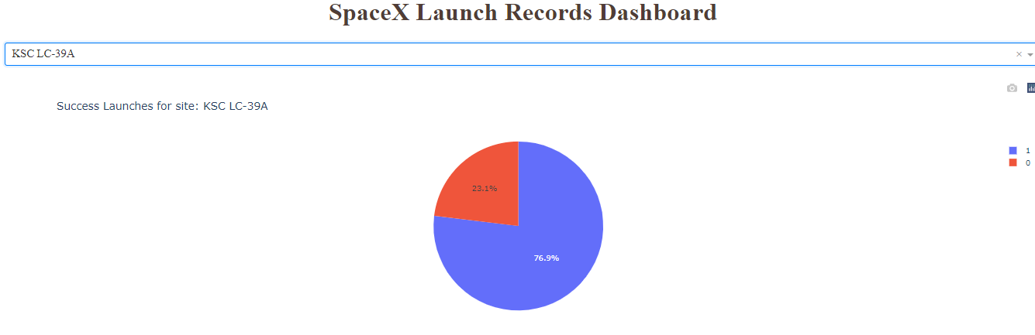
Launch Site success pie chart
KSC launch site has Highest success ratio
With launch success to be 76.9% and failure to be 23.1%

Slide 41
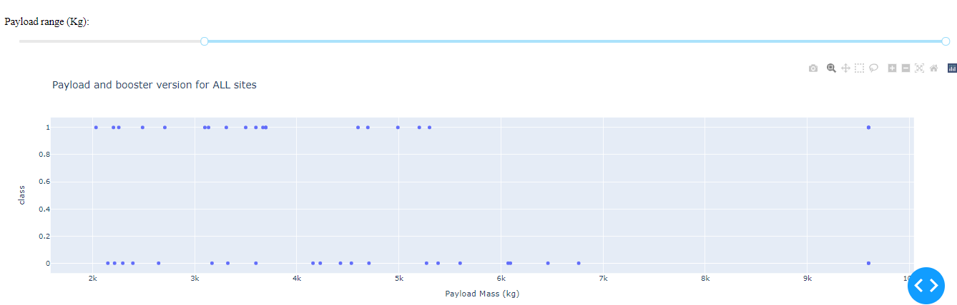
Payload mass vs Success Ratio
This Scatter plot showcase Payload vs. Launch Outcome for all sites, with different payload selected in the range slider

Slide 42


Slide 43
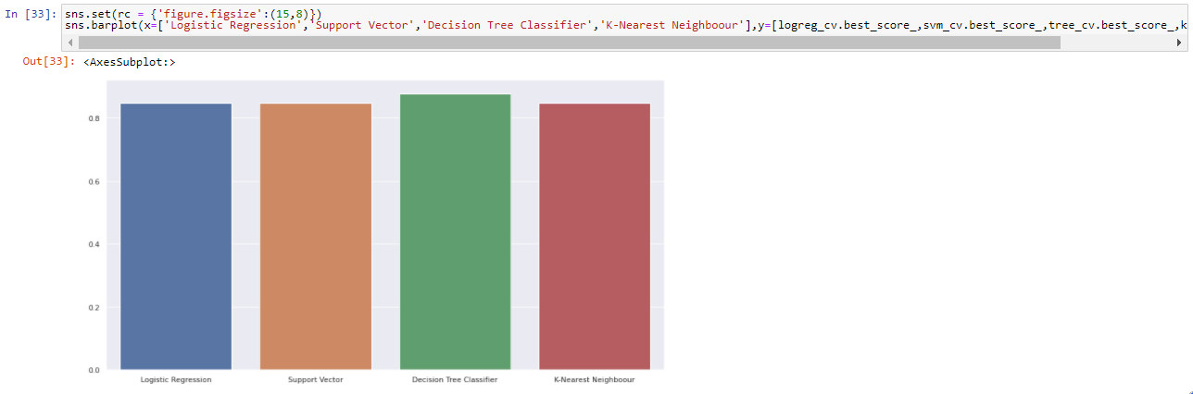
Classification Accuracy
As we can see that all the algorithm gave somewhat similar accuracy
But if we see carefully we’ll find out that Decision Tree classifier give little better result than others

Slide 44
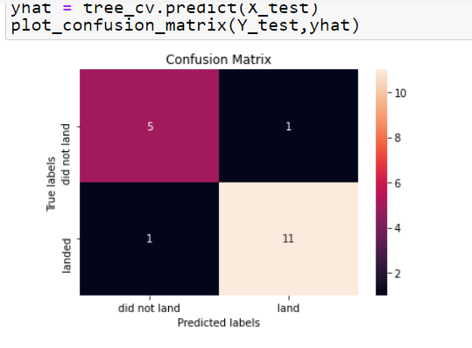
Confusion Matrix
Best performance matrix was found out to be of Decision tree classifier where it predicts 5 Unsuccessfull and 11 successful attempts correctly
1 launch that did not land, the alogorithm predicted it to land and another 1 launch that landed was predicted to not land

Slide 45
Conclusions
For competing to win the space market data scientist should find a way to predict the cost of the rocket launch
We used methodology such as EDA with Visualisation,EDA with sql,Visualisation with Folium to better understand the scenario.These helped us to derive relation between columns/field of dataset with each other
Python library helped us to find that Decision Tree Classifier is best machine learning model among various other models.Accuracy for predicting launch cost is best for Decision Tree Classifier

Slide 46
Appendix
Include any relevant assets like Python code snippets, SQL queries, charts, Notebook outputs, or data sets that you may have created during this project

Slide 47


